Slide 1
OLIST TEAM 1 PRESENTATION

Slide 2
INTRODUCTION
Cyril Fofana
Akriti Dhandhania
Charlton D’Souza
Chi Ezeogu
Becky Leach
Enrique Molero

Slide 3
In a snapshot
rating
4.09
average
reached
96k
customers
tied up with
3095
sellers
received
99.22k
reviews
fulfilled
112.65K
orders
presence in
27
states
have sold
32k
products
across
71
product categories

Slide 4
I. Payment, products and Sales overview

Slide 5
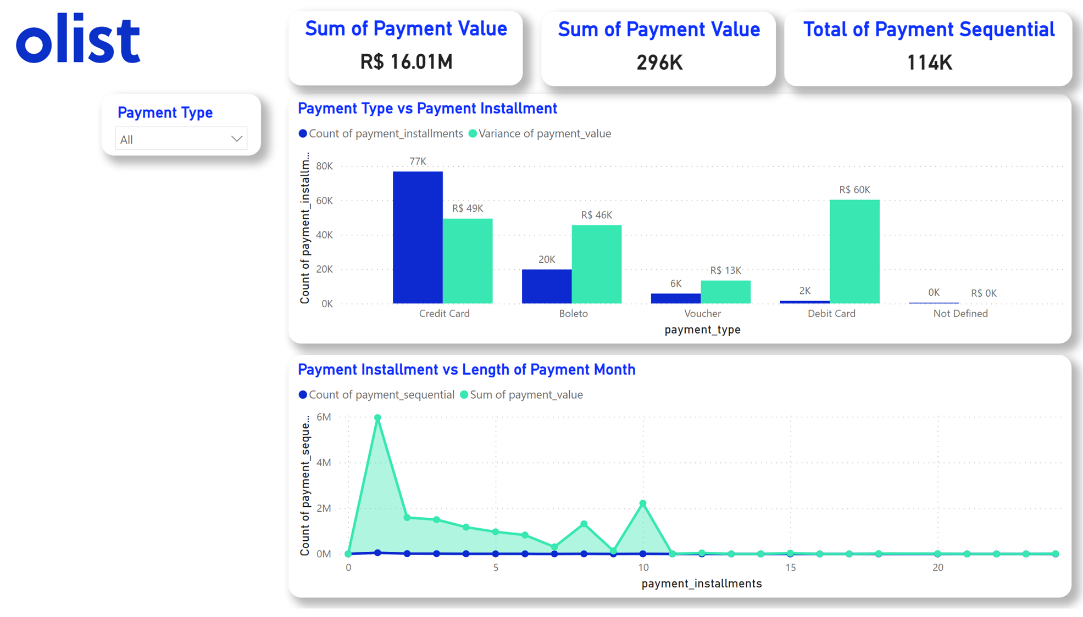
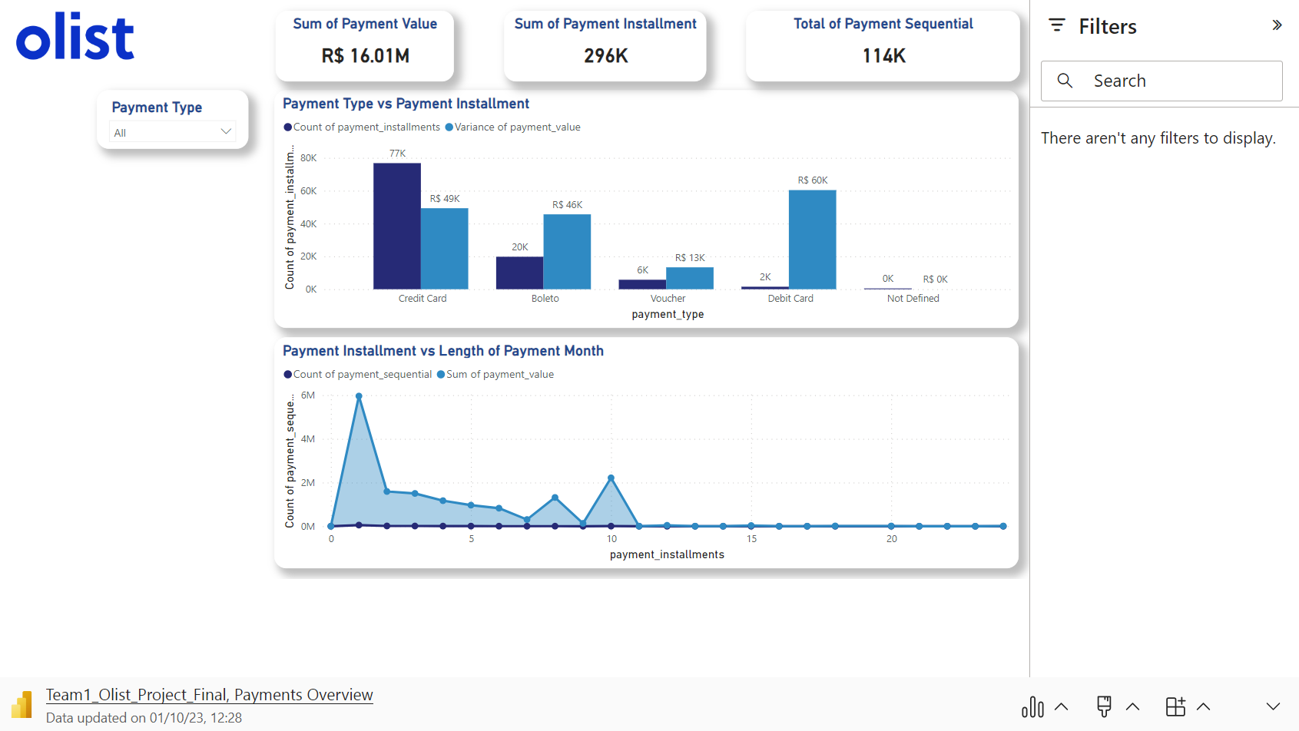

Slide 6
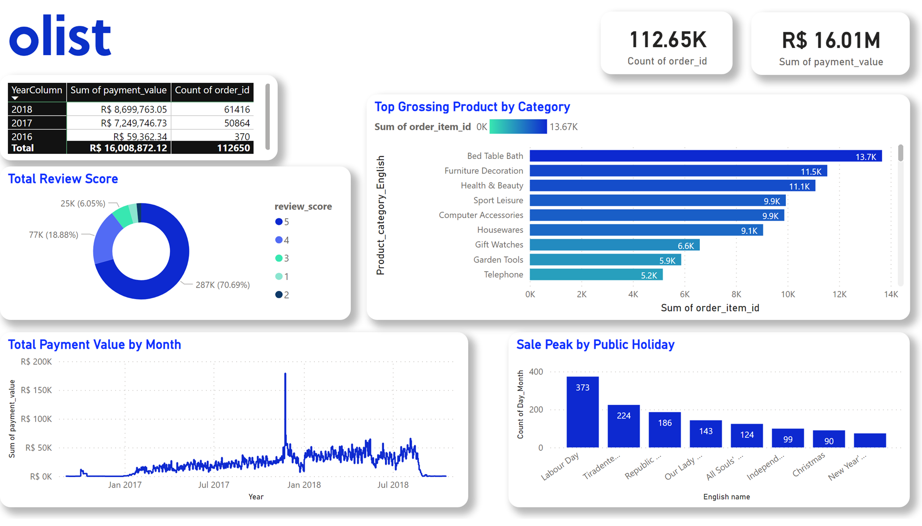
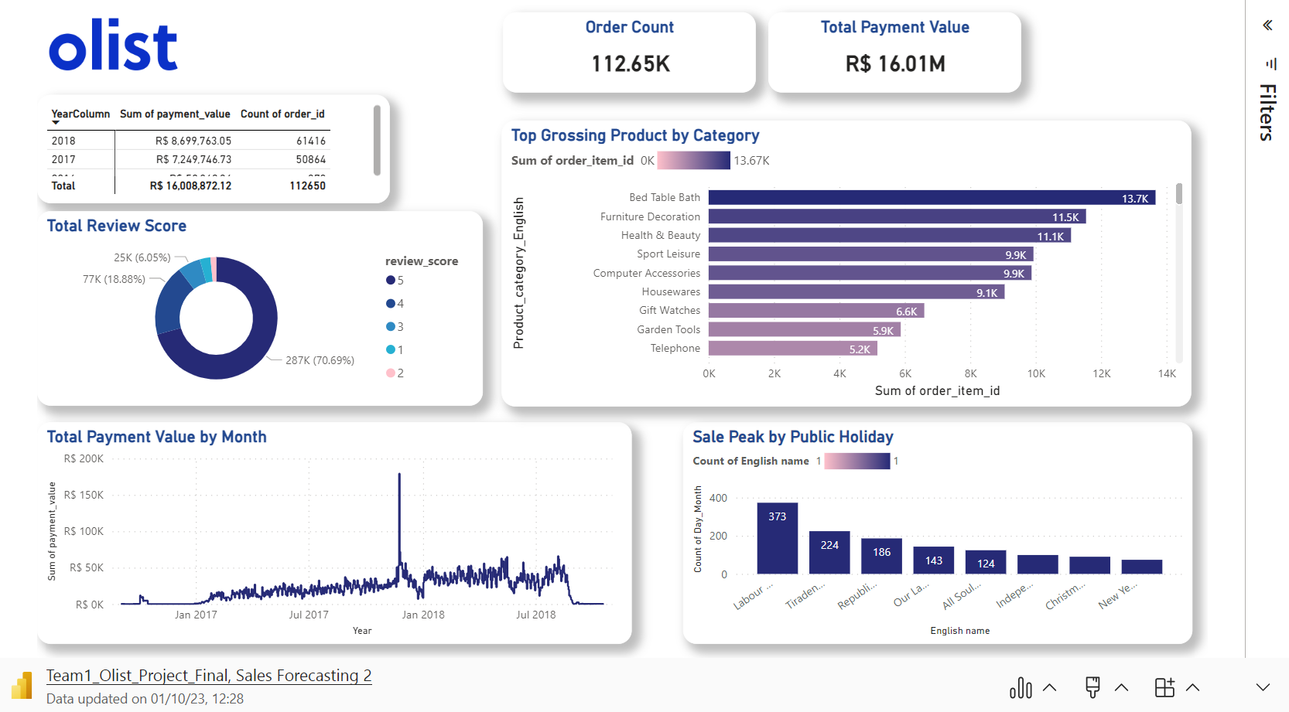

Slide 7
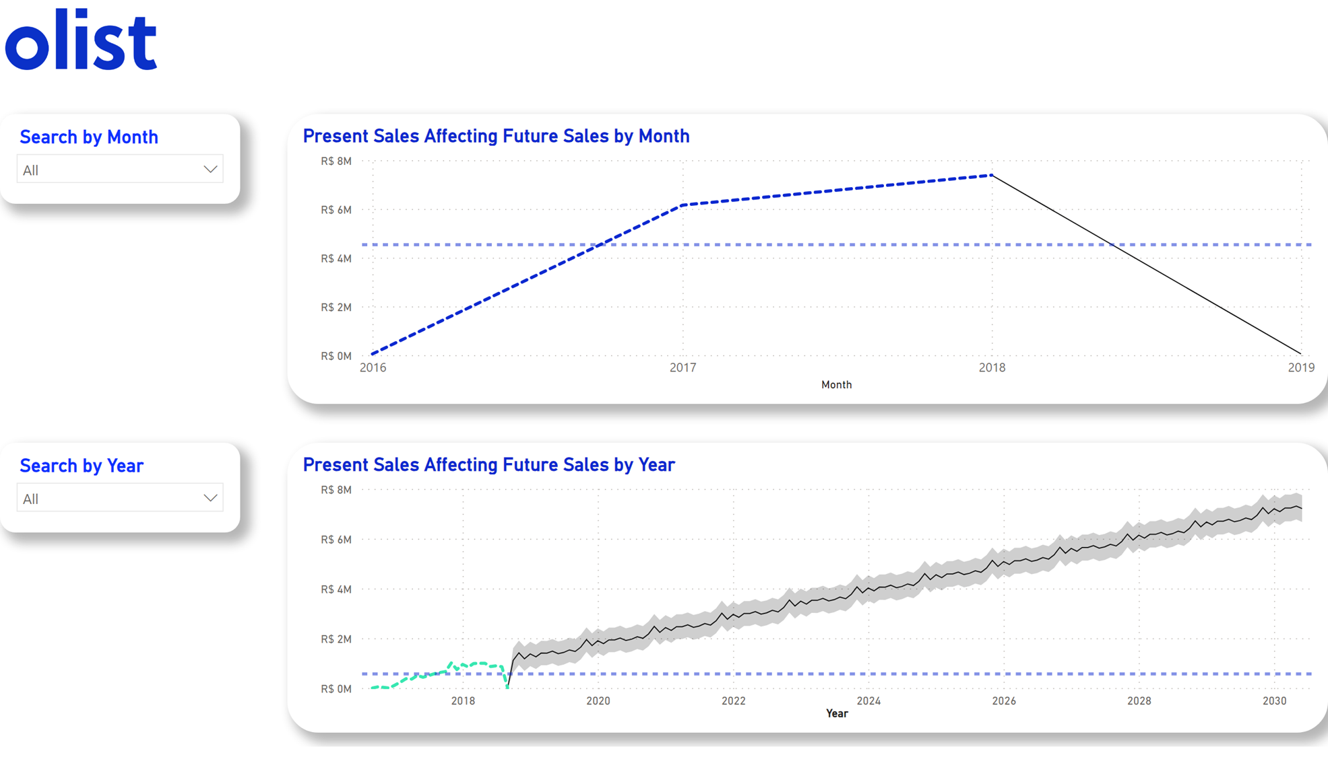
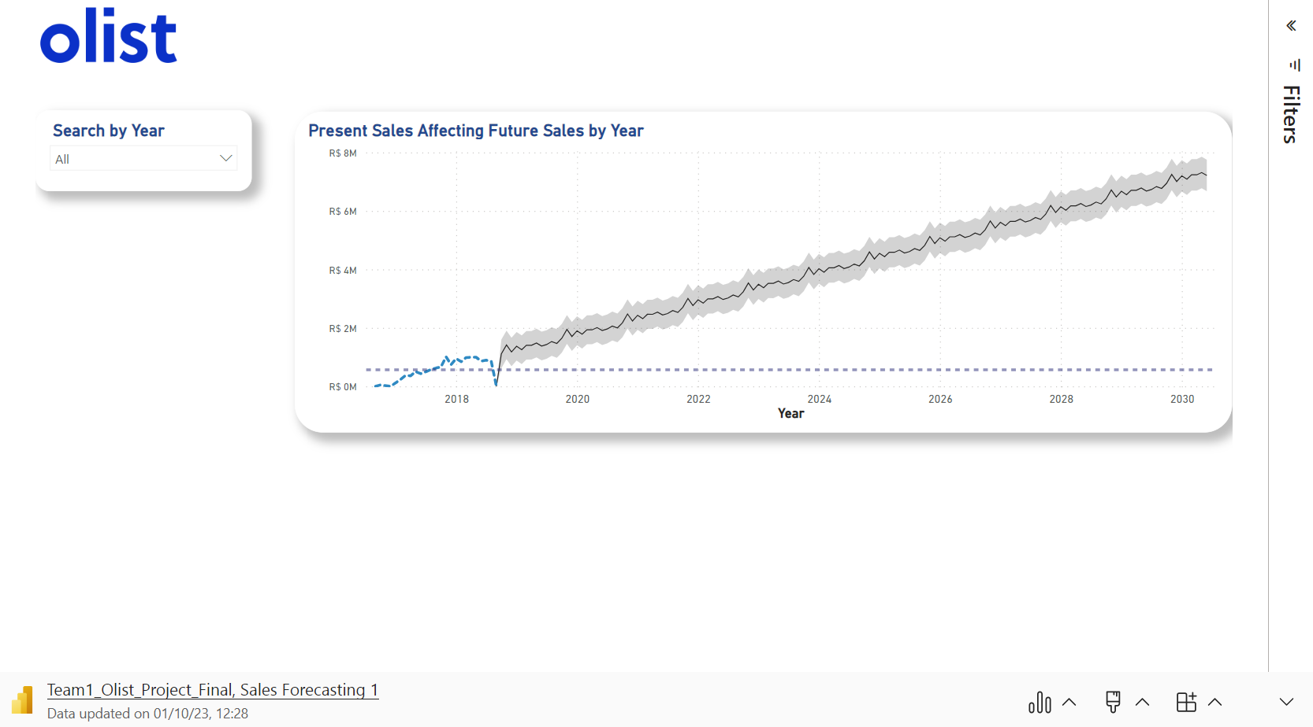

Slide 8
I. Key insights
Delving into payment types
Payment types in Brazil revealed a few things, the first being Bolero and how it is similar to the Klarna payment system and also seeing that credit card are still being massively used in the country although it is low income.#teamOlist
Looking into highest earning categories
The most popular items sold had a revenue difference of less than $1 million Brazilian Dollars, Health & Beauty coming out on top shows us where the marketing could concentrate all their efforts to further increase revenue or diversify. #teamOlist
Predicting future sales
The growth forecast is looking rather positive over the coming years, although performance will present some slight dip in revenue in the early months due to seasonality and / or products sold. #teamOlist

Slide 9
II. RECOMMENDATIONS
Facilitate new entrepreneurs
To promote their products on #olist website
Widen presence in main market places
In Brazil as #official Olist store
Evolve app to be more user friendly
To virtually showcase the #products

Slide 10
I. Customer reviews

Slide 11
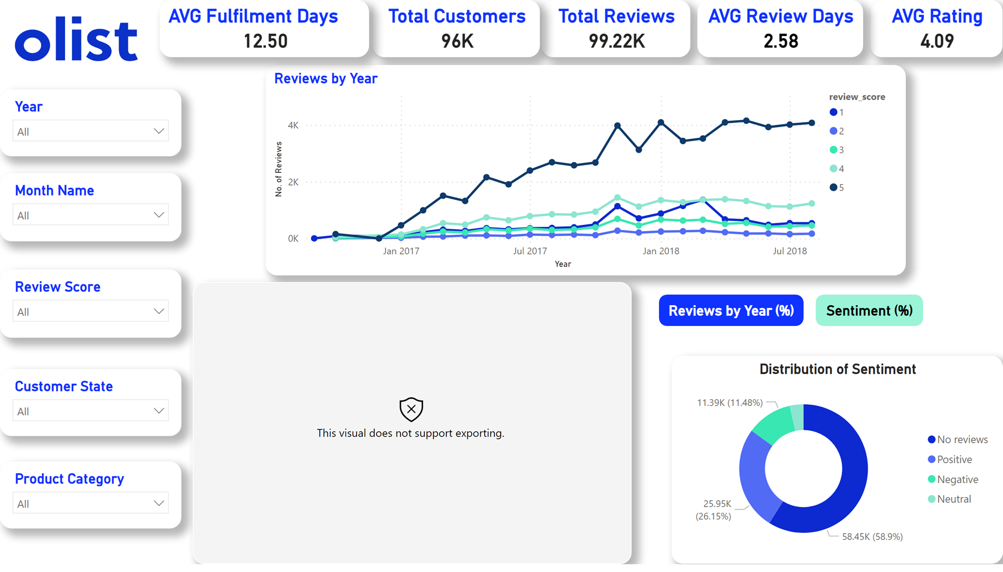
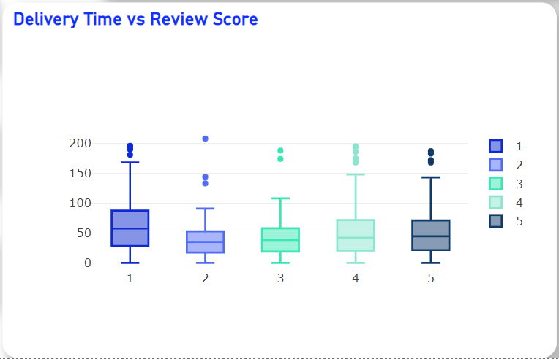
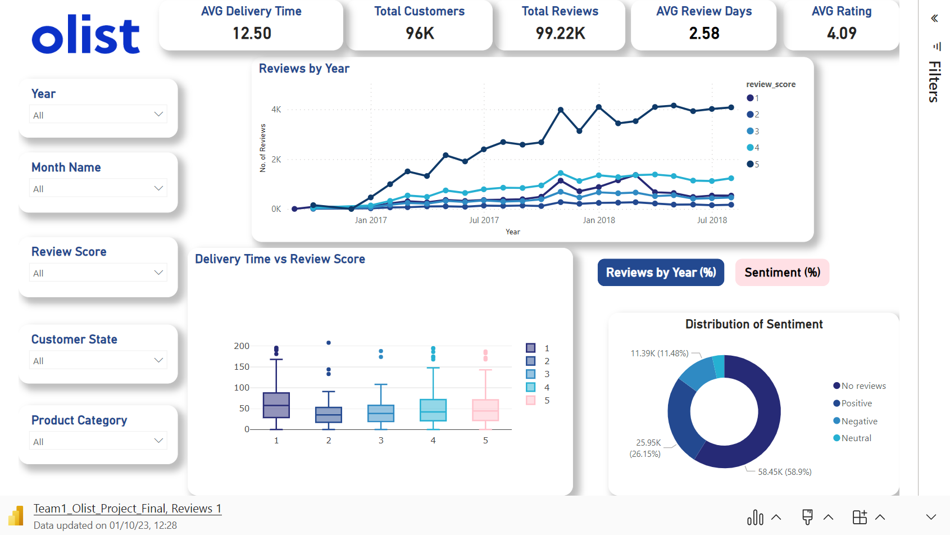

Slide 12
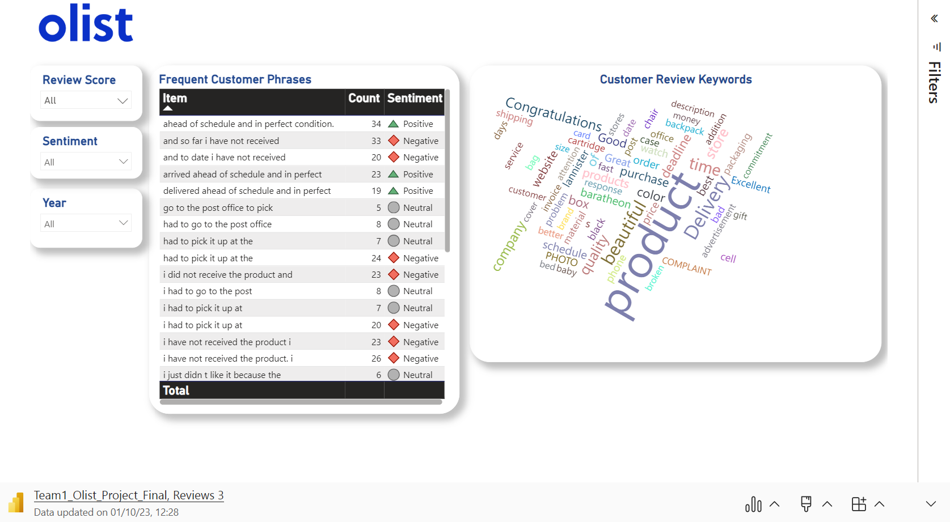
KeyWords Cloud

Slide 13
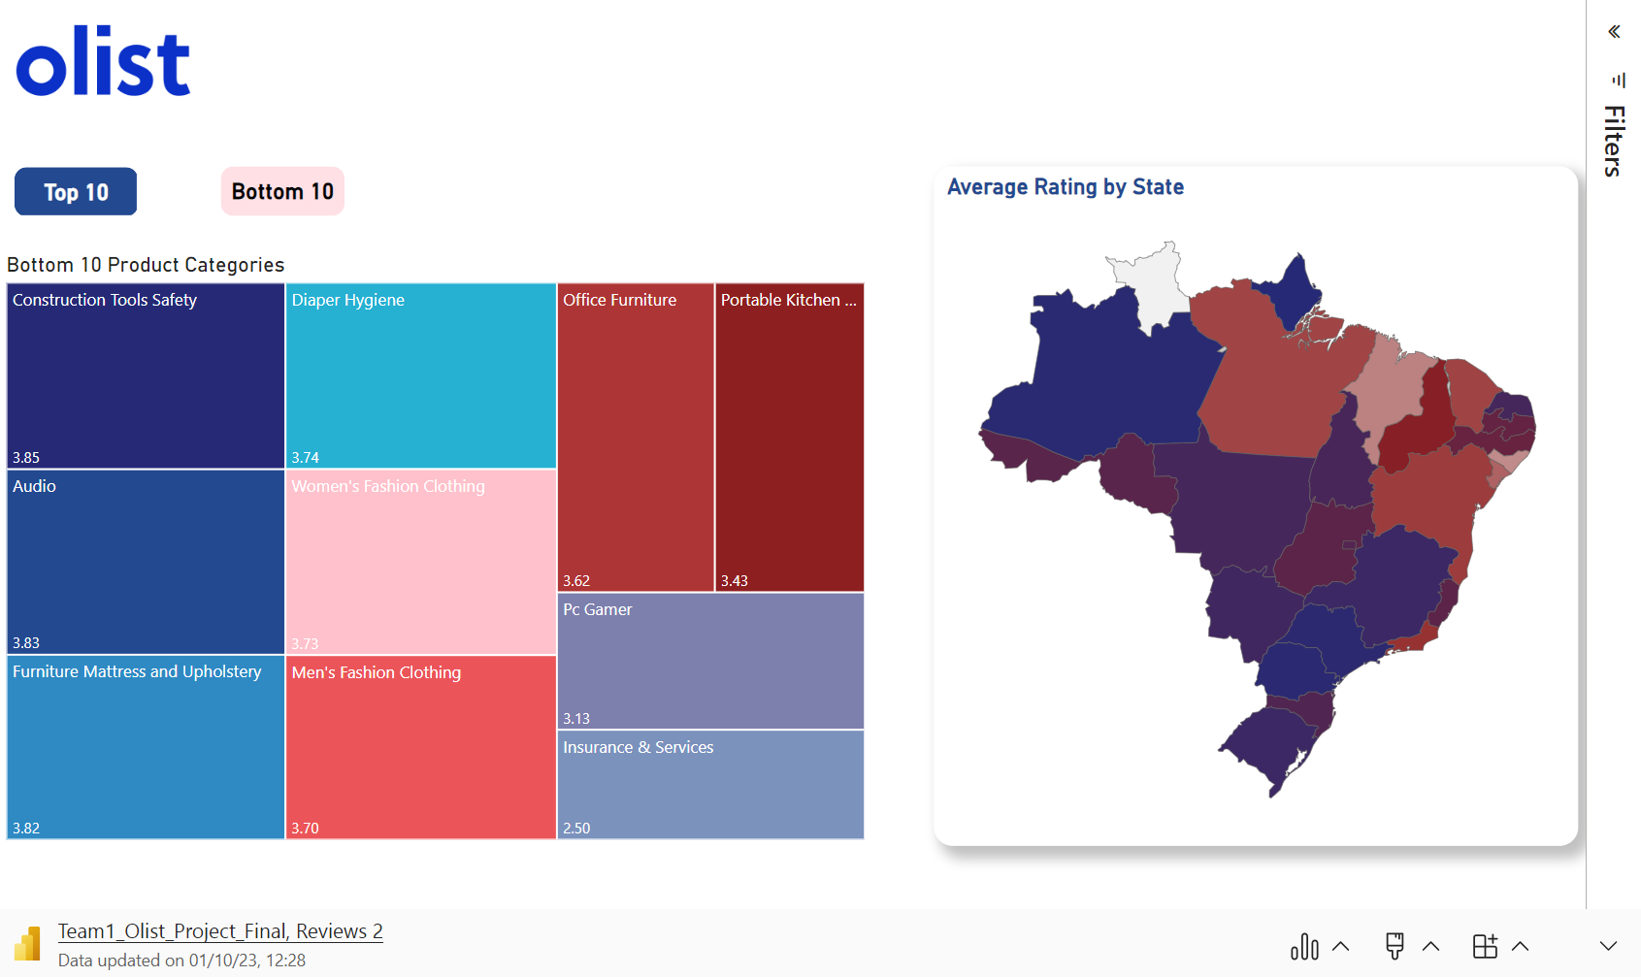
TEST
TEST 1
TEST 2
TEST 3
TEST 4
TEST 5
Describe here your metrics 1
Describe here your metrics 2
Describe here your metrics 3
Describe here your metrics 4

Slide 14
Positive review phrases
Frequent Phrases | Count | Sentiment
Ahead of schedule and in perfect condition. | 34 | Positive
Arrived ahead of schedule and in perfect | 23 | Positive
The product arrived ahead of schedule and | 22 | Positive
The product arrived in perfect condition and | 21 | Positive
I received the product well before the | 20 | Positive

Slide 15
Neutral review phrases
Frequent Phrases | Count | Sentiment
To go to the post office to | 9 | Neutral
I had to go to the post | 8 | Neutral
Had to go to the post office | 8 | Neutral
I had to pick it up at | 7 | Neutral
Had to pick it up at the | 7 | Neutral

Slide 16
negative review phrases
Frequent Phrases | Count | Sentiment
to pick it up at the post | 37 | Negative
and so far i have not received | 33 | Negative
i have not received the product. i | 26 | Negative
so far i have not received any | 25 | Negative
had to pick it up at the | 24 | Negative

Slide 17
IIi. Key insights
Rating 5 consistently outperforms other ratings in all months.
In certain months, Rating 1 closely matches Rating 4, and in one instance, it even surpasses it.
Certain customers across all ratings experienced a substantial delay despite the average delivery time being 12.50 days.
The conducted sentimental analysis consistently highlighted ‘product delivery’ as a key determinant of customer satisfaction.

Slide 18
Iv. recommendations
Evaluate the logistics procedure
to #prevent individuals from collecting items directly from the post office.
Investigate reasons
for #low rating in Security & Services category, and partner with new sellers.
Examine the reasons
#behind the Eastern region receiving an average rating below 4 across all product categories.

Slide 19
I. Delivery & logistics

Slide 20
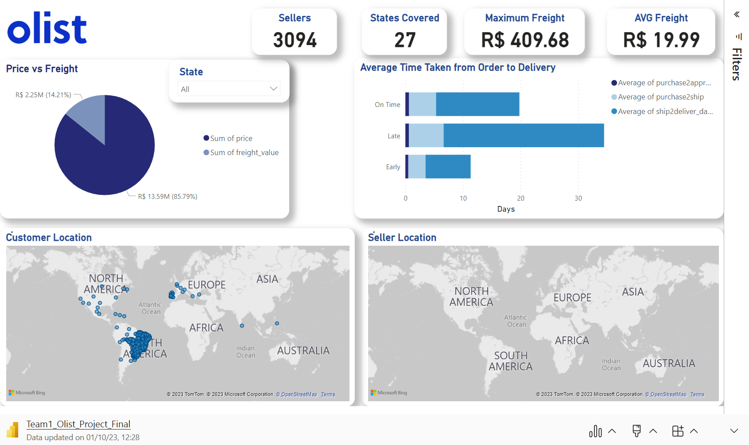
I. Delivery & logistics

Slide 21

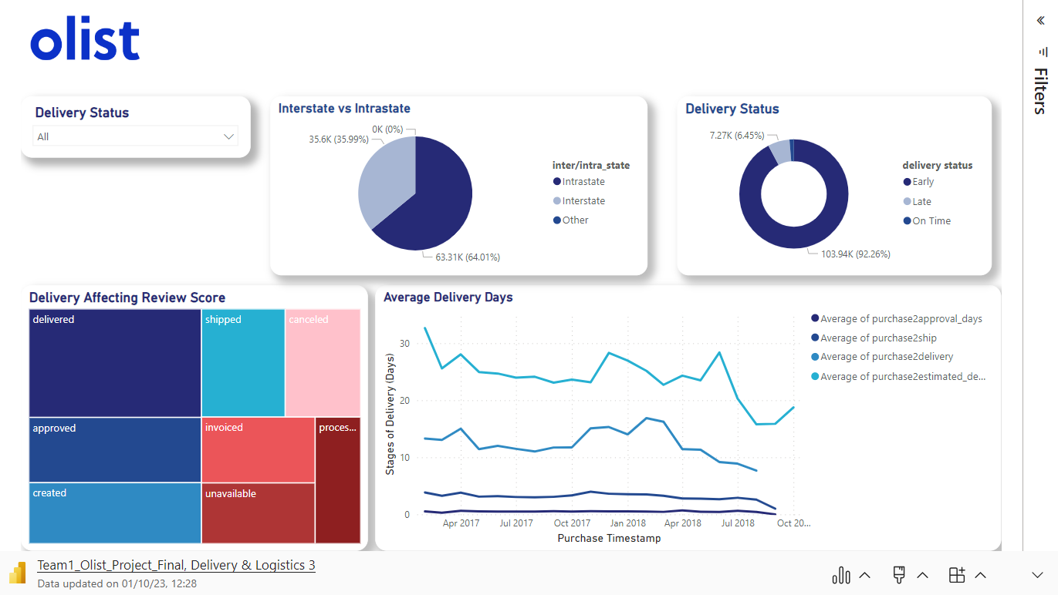
Key Insights….
Freight value is quite substantial
increasing the #total price after freight that customers must pay
Late deliveries usually have a bottleneck
At #‘shipment to delivery’ part of the delivery cycle
Customers have a strong presence in North& South Eastern region
however, #sellers are mostly present in #South Eastern Region
Estimated Delivery always stated too long
To always ensure #delivery fulfilment in time

Slide 22
v. Key insights
Freight value is quite substantial
increasing the #total price after freight that customers must pay
Late deliveries usually have a bottleneck
At #‘shipment to delivery’ part of the delivery cycle
Customers have a strong presence in North& South Eastern region
however, #sellers are mostly present in #South Eastern Region
Estimated Delivery always stated too long
To always ensure #delivery fulfilment in time

Slide 23
vI. recommendations
Tie up with more interstate sellers & retailers
to #expand scale & reach more customers, especially North-East located customers
Reduce estimated delivery time
To encourage #more purchase by new/existing buyers
Tie up with logistic specialised companies
Including them to be part of product ecosystem & find ways to #reduce freight value & reduce delivery time
Implement effective delivery systems
To reduce #bottleneck in ‘approval to shipment’ & ‘shipment to delivery’ ecosystem

Slide 24
THANK you
Please keep this slide for attribution.

